Slide 1
Monthly Look:
March
202.741.0886
educationombudsman.dc.gov
ombudsman@dc.gov

Slide 2
The DC Office of the Ombudsman for Public Education is an impartial, independent, and neutral office that uses mediation and conflict resolution to resolve complaints and concerns for parents and families regarding public education in the District of Columbia. The Office uses an “Activist Ombudsman” approach. We believe it is our responsibility to speak out against the systemic inequities that hurt our city’s children.

Slide 3
Role of the Education Ombudsman
Respond to complaints and concerns, and serve as an informational resource to families and students.
De-escalate and repair relationships through creative problem-solving and conflict resolution techniques.
Provide technical assistance to community organizations, LEAs, and education stakeholders on public education issues.
Act as an early warning system of new, emerging issues and trends to school leaders, education stakeholders, and elected/appointed officials.
Leverage case trends to contribute to city-wide conversations regarding cross-sector education systems to effect systemic change.

Slide 4
This shows how the Office of the Ombudsman primarily works with disputes during the disagreement and conflict stages of the DC Dispute Resolution Continuum*. It is in these stages where we complete our one-on-one case management. We use the data from those cases to form recommendations to create systemic change in hopes of preventing similar disputes in the future.

Slide 5
Our Core Values
Ensure Access | Our office aims to ensure access to equitable public education for all students, regardless of race, class, income, disability status or ward of residence.
Address Issues | We address issues that are brought to our attention by providing direct intervention for students and families; We also address these same issues on the systemic level through our engagement with local, state, and national education leaders.
Amplify Student and Family Voice | Our office serves as a venue for families to have voice in directly addressing the issues their student is facing and the school level. In many instances such issues are systemic inequities that are causing our children, particularly children of color and students with disabilities, to fail.
Reduce Systemic Inequities | We believe it is our responsibility to speak out against the systemic inequities that hurt our city’s children. We believe that through our work, and in our partnership with families and schools, we are creating a barrier-free system in which education equity is the primary focus. Such a system will allow students and families to benefit fully from their public school systems.

Slide 6
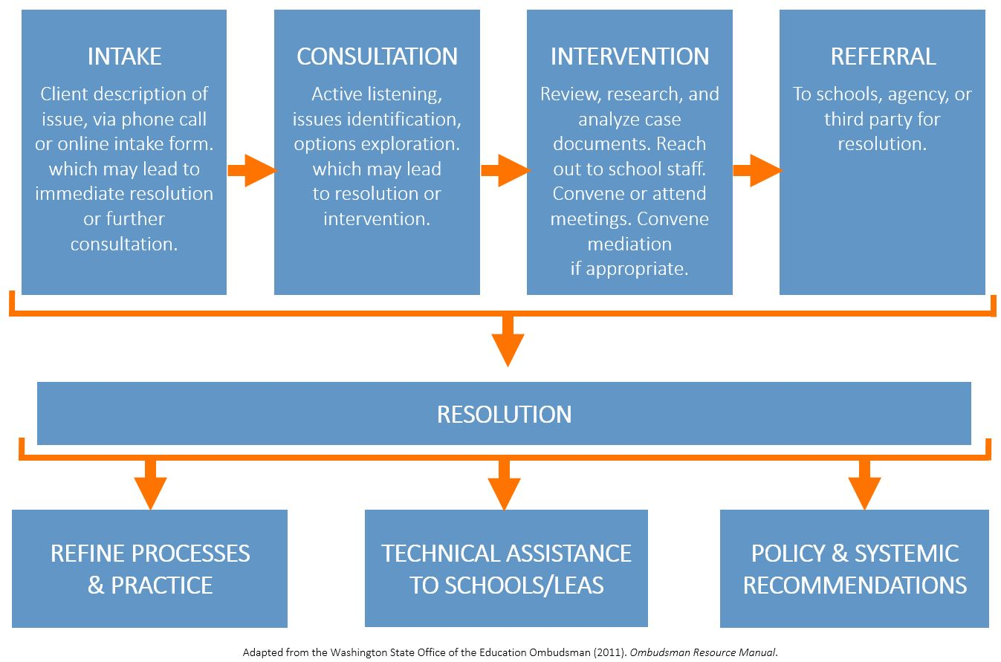
How We Serve: Our Process
During intake, we ask a series of questions to determine the scope of the callers concerns and to determine if further consultation and actions are required.
During consultation, we work to understand the caller’s perspective and help identify additional issues and contributing factors.
During the Intervention stage we work as an impartial third party to help reach a resolution.
We understand that sometimes there are other partners who can better address the issues- in those cases we make a referral.
Our process is designed to allow for a resolution at any point. We use the data we collect from cases to :
Refine or processes and practice
Develop and provide technical assistance to schools and local education agencies
Create police and systemic recommendations.

Slide 7
Contact Summary Total number of contacts received this month and describes the action taken.
Total Contacts | 105
Total Converted to Cases | 71
A contact becomes a case when we determine that our direct intervention is necessary to most appropriately address issue.
Monthly View: March 2019
Notes:
Conflict Resolution and Mediation
Our staff de-escalates conflict and provides creative problem-solving to families to help repair the relationship and meet the best needs of the child.
Systemic Recommendations
The trends we observe are incorporated into the recommendations and advocacy we do on a citywide basis.
Technical Support
By identifying consistent problems that impact the school system, we are better able to serve both schools and education stakeholders in improving their own processes.

Slide 8
Yearly Comparison by Month This chart compares this month this year (SY2018-19) to this month last year (SY2017-18).
Monthly View: March 2019

Slide 9
Cases by Category
This chart represents all cases collected this month.
Monthly View: March 2019

Slide 10
Category Definitions
This is list provides definitions for the categories shown on the previous slide.
Academic Progress: Issues preventing a student from accessing their education related to grades, credits, transcripts, and curriculum that impact learning or perception of learning.
Access: Issues preventing a student from accessing their education unrelated to the curriculum, or due to procedural difficulties or gaps
Communication: Issues preventing a student from accessing their education due to real or perceived breakdowns in productive communication.
Special Education: Issues preventing a student from accessing their education due to a student’s diagnosed or suspected disability.
School Environment: Issues preventing a student from accessing their education due to the safety, behavior, and environment issues, or actions of students or staff against the student that signal a need for intervention or support from the school.
Bullying: School Environment issues in which a member of the school community is bullying a student. This includes the legal definition, a family member’s impressions, and sexual assault.
Discipline - Expulsion/Suspension: Issues regarding a student who has been temporarily or permanently placed out of school due to a behavior or disciplinary infraction.
Other: Issues preventing a student from accessing their education due to issues unrelated to any of the other issues.

Slide 11
Cases by Special Education Services
Cases involving a student receiving special education services.
Type of Service
Category of Case
45%
of the cases this month involve a student who receives special education services.
These cases include cases that do not have special education as a central issue. These charts shows that students who receive special education services experience a wide range of issues.
Monthly View: March 2019

Slide 12
Cases by Ward
This chart represents all cases collected this month.
This chart takes the calls we get from students in each ward and separates that data by whether those students attend a school located within their ward of residence.
For example, we opened 20 cases involving students who live in Ward 7. Only 7 of those cases involved schools also located in Ward 7.
Monthly View: March 2019

Slide 13
Cases by Ward
This chart represents all cases collected this month.
This chart takes the cases we opened involving schools in each ward and dissects that data by the school type for each caller.
For example, of the 10 cases we received that involved a school in Ward 7, only 3 of those calls involved in boundary students at that Ward 7 school.
Monthly View: March 2019

Slide 14
Cases by School Type
This chart represents all cases collected this month.
Monthly View: March 2019

Slide 15
Cases by Student Race
This chart represents all cases collected this month.
Overall DC Student Population According to Education Forward DC
Our Cases
Monthly View: March 2019

Slide 16
We look forward to working with you!
202.741.0886
educationombudsman.dc.gov
ombudsman@dc.gov

