Slide 1
Quarter 2 Report
November 1, 2018 – January 31, 2019
202.741.0886
educationombudsman.dc.gov
ombudsman@dc.gov

Slide 2
The DC Office of the Ombudsman for Public Education is an impartial, independent, and neutral office that uses mediation and conflict resolution to resolve complaints and concerns for parents and families regarding public education in the District of Columbia. The Office uses an “Activist Ombudsman” approach. We believe it is our responsibility to speak out against the systemic inequities that hurt our city’s children.

Slide 3
Role of the Education Ombudsman
Respond to complaints and concerns, and serve as an informational resource to families and students.
De-escalate and repair relationships through creative problem-solving and conflict resolution techniques.
Provide technical assistance to community organizations, LEAs, and education stakeholders on public education issues.
Act as an early warning system of new, emerging issues and trends to school leaders, education stakeholders, and elected/appointed officials.
Leverage case trends to contribute to city-wide conversations regarding cross-sector education systems to effect systemic change.

Slide 4
This shows how the Office of the Ombudsman primarily works with disputes during the disagreement and conflict stages of the DC Dispute Resolution Continuum*. It is in these stages where we complete our one-on-one case management. We use the data from those cases to form recommendations to create systemic change in hopes of preventing similar disputes in the future.

Slide 5
Our Core Values
Ensure Access | Our office aims to ensure access to equitable public education for all students, regardless of race, class, income, disability status or ward of residence.
Address Issues | We address issues that are brought to our attention by providing direct intervention for students and families; We also address these same issues on the systemic level through our engagement with local, state, and national education leaders.
Amplify Student and Family Voice | Our office serves as a venue for families to have voice in directly addressing the issues their student is facing and the school level. In many instances such issues are systemic inequities that are causing our children, particularly children of color and students with disabilities, to fail.
Reduce Systemic Inequities | We believe it is our responsibility to speak out against the systemic inequities that hurt our city’s children. We believe that through our work, and in our partnership with families and schools, we are creating a barrier-free system in which education equity is the primary focus. Such a system will allow students and families to benefit fully from their public school systems.

Slide 6
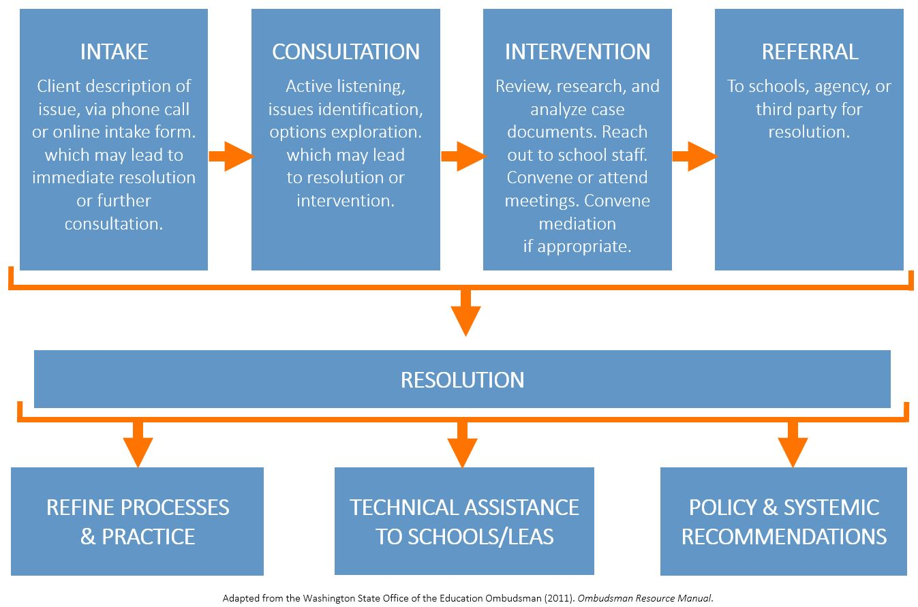
How We Serve: Our Process
During intake, we ask a series of questions to determine the scope of the callers concerns and to determine if further consultation and actions are required.
During consultation, we work to understand the caller’s perspective and help identify additional issues and contributing factors.
During Intervention we work as an impartial third party to help reach a resolution.
We understand that sometimes there are other partners who can better address the issues- in those cases we make a referral.
Our process is designed to allow for a resolution at any point. We use the data we collect from cases to:
Refine our processes and practice
Develop and provide technical assistance to schools and local education agencies; and
Create policy and systemic recommendations.

Slide 7
Ways We Serve:
Examples of Our Practice and Our Support
for Families
Engagement - School Environment | A fourth grade student who stopped doing his classwork and homework because he became dejected from getting in trouble multiple times and being seen as the “problem child.” He became at risk for academic failure. We mediated a meeting to help the school come up with alternative ways of addressing any behavior problems and addressing his triggers. A fourth grade student who has a developmental delay and speech impairment has suicidal ideation as a result of bullying, which her mom feels the school has handled dismissively. We connected the parent to the school’s bullying coordinator to help develop a safety plan and arrange a victim transfer.
Disability - Special Education | A ninth grade student was retained three times and unable to attend class due to her crippling anxiety and severe emotional disturbance. We coached the family through obtaining an IEP evaluation and advised the school to implement accommodations through a 504 plan until results of evaluation were complete. A fifth grade student diagnosed with ADHD and hallucinations couldn’t be around a lot of people without misbehaving. He has been on a 504 plan for several years, which is no longer effective. We coordinated a placement meeting with the school to identify a better placement with smaller class sizes.
Access | A third grader with autism and anxiety/mood disorder was suspended after a behavior tech took away a magnet that his teacher allowed him to take outside of the classroom. His mom felt that the situation was handled inappropriately due to his diagnoses. We coordinated with the principal to share necessary accommodations with each teacher to prevent reoccurrence.
Notes:
Data Snapshot Slide
WHO WE SERVE
Five Data
Top issue areas
Wards percentage served
Race breakdown
Sector Breakdown
Grade Brand

Slide 8
Ways We Serve:
Our Work with Schools & Education Leaders
While we work with students and families, we also partner with LEAs and other education stakeholders
in the following ways:
Schools & Local Education Agencies | Mediating conversations between families and between families and LEAs. Providing technical support to LEAs on revisions to bullying and discipline policies. Researching policy on per-pupil funding reimbursement post enrollment count. Advising schools on how to implement McKinney Vento law and support families dealing with homelessness. Developing an individualized case report for a charter LEA to update their policies and procedures. Working with schools to plan out the implementation of services needed for a student with a disability or in need of behavior supports. Providing guidance and recommendations on new policies and procedures.
Other Education Stakeholders | Advising Council of the District of Columbia Committee on Education of developing a discipline floor to keep students in schools. Advising school founders on family engagement. Identifying discipline issues unique to charters for the Government Accountability Office.
Notes:
Data Snapshot Slide
WHO WE SERVE
Five Data
Top issue areas
Wards percentage served
Race breakdown
Sector Breakdown
Grade Brand

Slide 9
Contact Summary – Quarter 2 This chart represents all cases between November 1, 2018 and January 31, 2019.
This shows the total number of contacts our office received in Quarter 2 and what type of action was taken in response.
It also shows how many of those contacts (emails, calls, referrals) became cases that our staff actively worked to resolve.
Total Contacts | 243
Total Converted to Cases | 132
A contact becomes a case when we determine that our direct intervention is necessary to most appropriately address issue.
Quarter 2 Report: November 1, 2018 – January 31, 2019
Notes:
Conflict Resolution and Mediation
Our staff de-escalates conflict and provides creative problem-solving to families to help repair the relationship and meet the best needs of the child.
Systemic Recommendations
The trends we observe are incorporated into the recommendations and advocacy we do on a citywide basis.
Technical Support
By identifying consistent problems that impact the school system, we are better able to serve both schools and education stakeholders in improving their own processes.

Slide 10
Total Cases for Quarter 2 This chart represents all cases collected between November 1, 2018 and January 31, 2019.
Quarter 2 Report: November 1, 2018 – January 31, 2019

Slide 11
Total Cases per Quarter This chart compares the number of cases per quarter for the past 3 years.
Quarter 2 Report: November 1, 2018 – January 31, 2019

Slide 12
Cases by Category
This chart represents all cases collected between November 1, 2018 and January 31, 2019.
Category of Issue
Quarter 2 Report: November 1, 2018 – January 31, 2019

Slide 13
Category Definitions
This is list provides definitions for the categories shown on the previous slide.
Academic Progress: Issues preventing a student from accessing their education related to grades, credits, transcripts, and curriculum that impact learning or perception of learning.
Access: Issues preventing a student from accessing their education unrelated to the curriculum, or due to procedural difficulties or gaps
Communication: Issues preventing a student from accessing their education due to real or perceived breakdowns in productive communication.
Special Education: Issues preventing a student from accessing their education due to a student’s diagnosed or suspected disability.
School Environment: Issues preventing a student from accessing their education due to the safety, behavior, and environment issues, or actions of students or staff against the student that signal a need for intervention or support from the school. This category also includes bullying and corporal punishment.
Bullying: School Environment issues in which a member of the school community is bullying a student. This includes the legal definition, a family member’s impressions, and sexual assault.
Discipline - Expulsion/Suspension: Issues regarding a student who has been temporarily or permanently placed out of school due to a behavior or disciplinary infraction.
Other: Issues preventing a student from accessing their education due to issues unrelated to any of the other issues.

Slide 14
Cases by Category (Special Education)
This chart represents all cases collected between November 1, 2018 and January 31, 2019.
Student Ward of Residence
School Ward
32
Cases in Quarter 2 with Special Education as the core issue.
Student Grade Band
Student Race

Slide 15
Cases by Category (Bullying)
This chart represents all cases collected between November 1, 2018 and January 31, 2019.
Student Ward of Residence
School Ward
25
Cases in Quarter 2 with Bullying as the core issue.
Student Grade Band
Student Race

Slide 16
Cases by Student Race
This chart represents all cases collected between November 1, 2018 and January 31, 2019.
According to Education Forward DC, the student population in DC is
71% African American
17% Hispanic
9% Caucasian
2% Asian
2% Multiracial
Quarter 2 Report: November 1, 2018 – January 31, 2019

Slide 17
Cases by School Type
This chart represents all cases collected between
November 1, 2018 and January 31, 2019.
41
35
33
Quarter 2 Report: November 1, 2018 – January 31, 2019

Slide 18
Cases by School Type
This chart represents all cases collected between
November 1, 2018 and January 31, 2019.
Student Ward of Residence for
DCPS Out-of-Boundary Schools
Student Ward of Residence for
Public Charter Schools
Student Ward of Residence for
DCPS In-Boundary Schools
Quarter 2 Report: November 1, 2018 – January 31, 2019

Slide 19
Cases by Grade Band of Student
This chart represents all cases collected between November 1, 2018 and January 31, 2019.
Quarter 2 Report: November 1, 2018 – January 31, 2019

Slide 20
Cases by Ward
This chart represents all cases collected between
November 1, 2018 and January 31, 2019.
School Ward
Student Ward of Residence
Quarter 2 Report: November 1, 2018 – January 31, 2019

Slide 21
Ward Profile: Ward 8
This chart represents all cases collected between November 1, 2018 and January 31, 2019.
35
Cases in Quarter 2 Involving Students Who Live In Ward 8.
27
Cases in Quarter 2 Involving Schools In Ward 8.
Quarter 2 Report: November 1, 2018 – January 31, 2019

Slide 22
Ward Profile: Ward 7
This chart represents all cases collected between November 1, 2018 and January 31, 2019.
34
Cases in Quarter 2 Involving Students Who Live In Ward 7.
28
Cases in Quarter 2 Involving Schools In Ward 7.
Quarter 2 Report: November 1, 2018 – January 31, 2019

Slide 23
Ward Profile: Ward 6
This chart represents all cases collected between November 1, 2018 and January 31, 2019.
11
Cases in Quarter 2 Involving Students Who Live In Ward 6
24
Cases in Quarter 2 Involving Schools In Ward 6.
Quarter 2 Report: November 1, 2018 – January 31, 2019

Slide 24
Ward Profile: Ward 5
This chart represents all cases collected between November 1, 2018 and January 31, 2019.
14
Cases in Quarter 2 Involving Students Who Live In Ward 5.
15
Cases in Quarter 2 Involving Schools In Ward 5.
Quarter 2 Report: November 1, 2018 – January 31, 2019

Slide 25
We Look Forward to Partnering With You!
202.741.0886
educationombudsman.dc.gov
ombudsman@dc.gov

